Slide 1
APPLICATION OF
EYE GAZE DETECTION
FOR ALS PATIENTS
Team members:
Y. Tarakaram
Y. Lakshmi Prasanna
Y. Mounika

Slide 2
CONTENTS
INTRODUCTION
THEORY
IMPLEMENTATION
MODULES
FUNCTIONS
OUTPUTS

Slide 3
INTRODUCTION
Amyotrophic lateral sclerosis (ALS) is a group of rare neurological diseases that mainly involve the nerve cells (neurons) responsible for controlling voluntary muscle movement.
Currently, there is no cure for ALS and no effective treatment to halt, or reverse, the progression of the disease.
Patients may experience slurred speech, which can become more severe with time, or even completely lose the ability to speak (dysarthria).
Since they cannot speak with their mouth, they can use their eyes for communication. So, based on their eye movement they can communicate with others.
We have built an application for them using gaze detection.
The application which we have done makes use for the patients to order the food, listen to songs, watch videos and type something using a keyboard menu.

Slide 4
THEORY
This application is built in two main steps.
Detection of eye
Virtual Menu
Detection of eyes is important because their movement and blinking are the main part of this project.
We need to detect two eyes separately:
Left eye points: (36, 37, 38, 39, 40, 41)
Right eye points: (42, 43, 44, 45, 46, 47)
Now we have calculated the vertical midpoints of the eye.
These midpoints can be used to detect the blinking of the eye. Blinking is used to select items from the menu.
We can note that if the eye is closed, the distance between the horizontal end points of the eye is almost the same. But the distance between the vertical points is very less compared to when it is open.

Slide 5


Slide 6
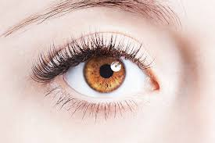
So to detect the blinking, we use the horizontal distance as reference and calculate the ratio of the horizontal distance and vertical distance. So, we use this ratio and we can tell if the eye is blinking or not.
Now, we have to detect the gaze of the eye.
Generally, the eye is composed of three parts.
Pupil – the black circle in the middle
Iris – the bigger circle that can have different color for different people
Sclera – it’s always white

Slide 7
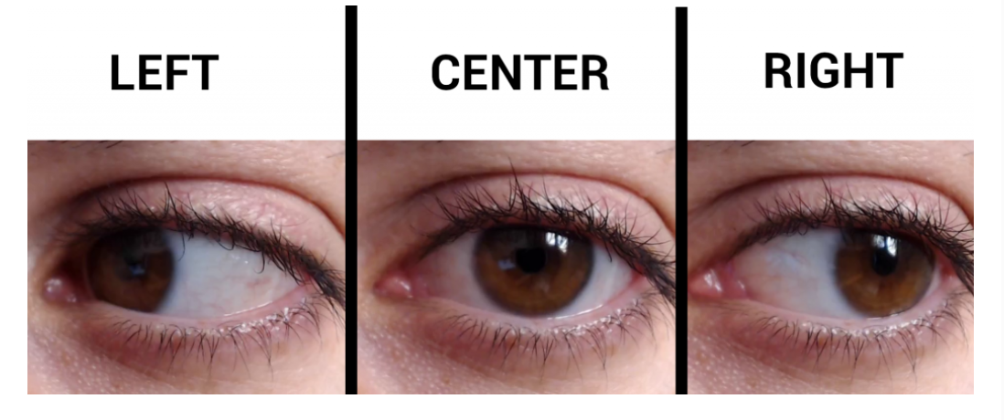
We can easily infer that the sclera which is the white part of the eye covers the left part of the eye when we look at the right side and vice versa.
We divide the eye into two parts.

Slide 8
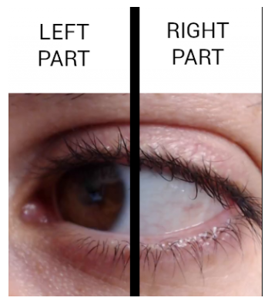
We can say that the sclera(white part) is more visible on the right side since the eye is looking towards the left.
So, we can convert the eye into a threshold and then count the white pixels on both the sides and then we can calculate the gaze ratio using the count of white pixels on the left and right.
This we do for the both eyes and then take the average of it as gaze ratio.

Slide 9
IMPLEMENTATION
MODULES
openCV
dlib
numpy
math
pyglet
mutagen
win32com
ffpyplayer
glob
time

Slide 10
FUNCTIONS
Blinking based option selection boards
def draw_letters(letter_index, items, letter_light)
def draw_menu(item_index, items, letter_light)
def draw_items(item_index, items, letter_light)
def draw_items(item_index, items, letter_light)

Slide 11
Gaze based option selection boards
draw_keyboard()
draw_keyboard_1()
draw_keyboard_2()
draw_keyboard_3()
For eye detection
midpoint(p1,p2)
get_blinking_ratio(eye_points,facial_landmarks)
eye_contour_points(facial_landmarks)
get_gaze_ratio(eye_points,facial_landmarks)

Slide 12
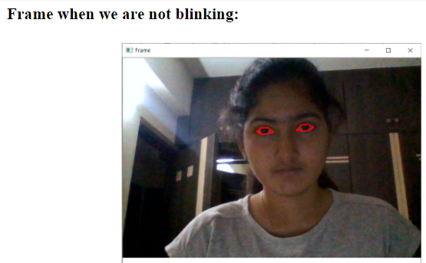
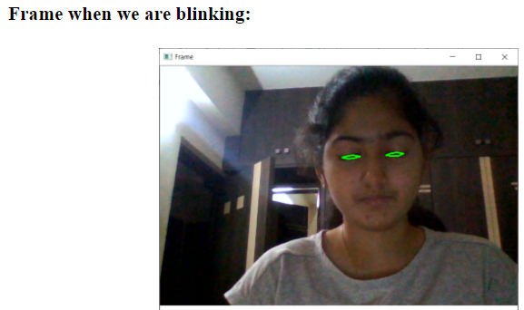
OUTPUTS

Slide 13
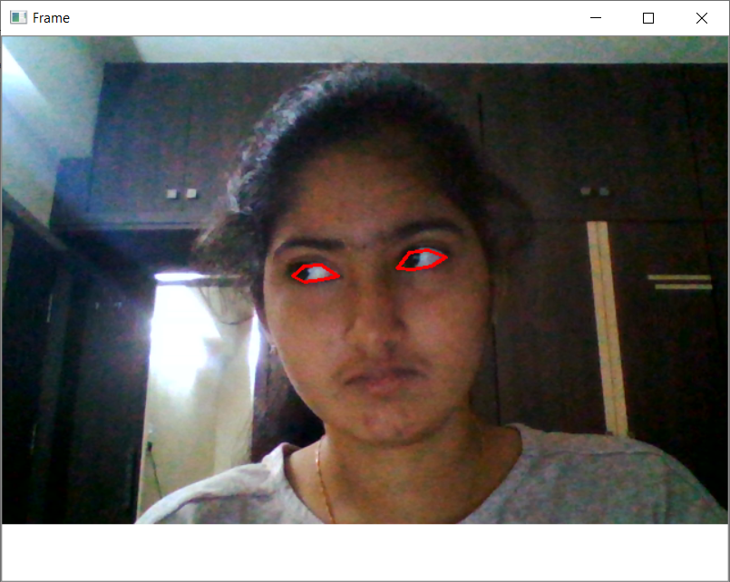
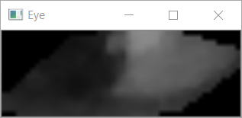
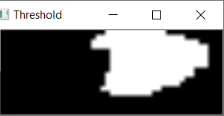
Frame when looking right side:
Eye when looking right side:
Threshold eye when looking right side:

Slide 14
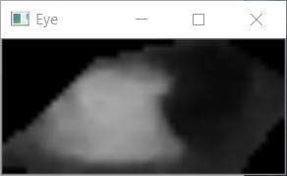
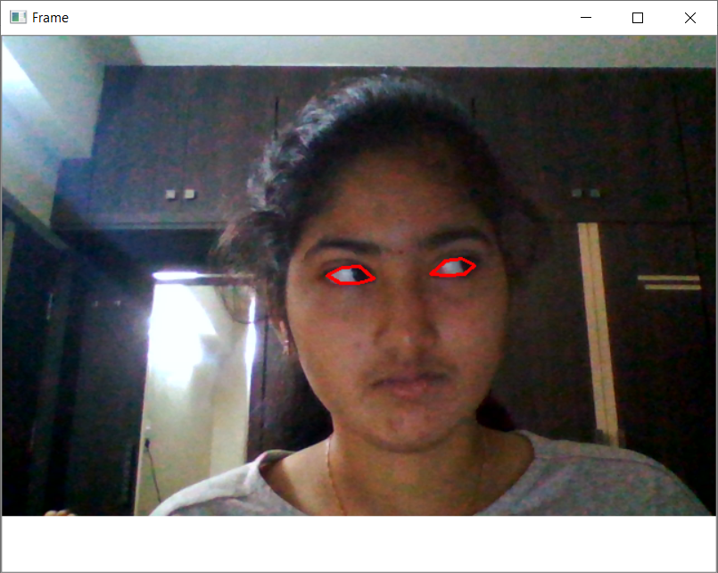
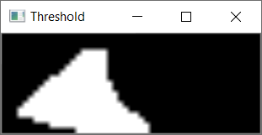
Eye when looking left side:
Frame when looking left side:
Threshold eye when looking left side:

Slide 15
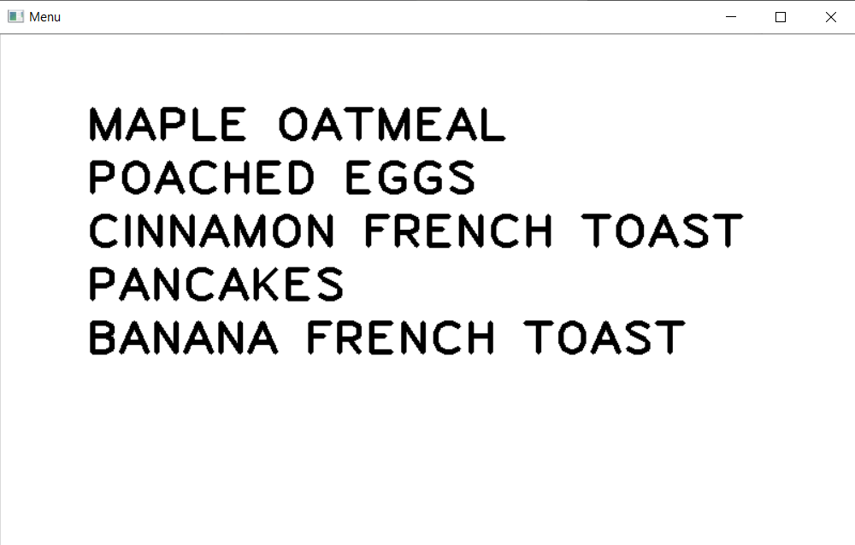
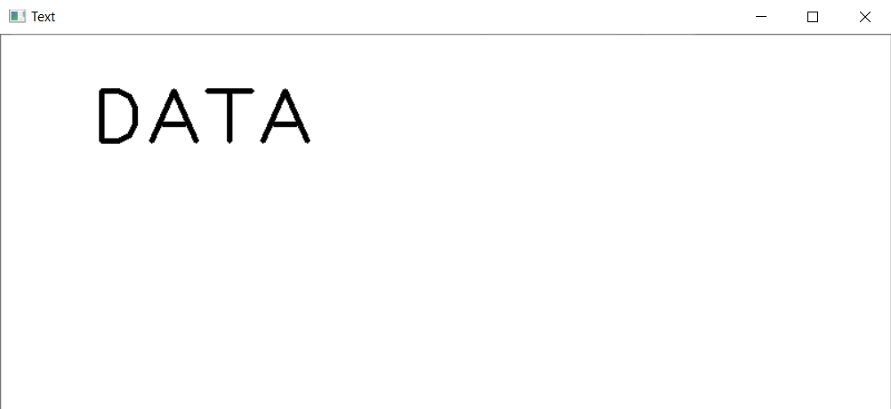
Board after menu is selected:
Board after text is typed:

Slide 16
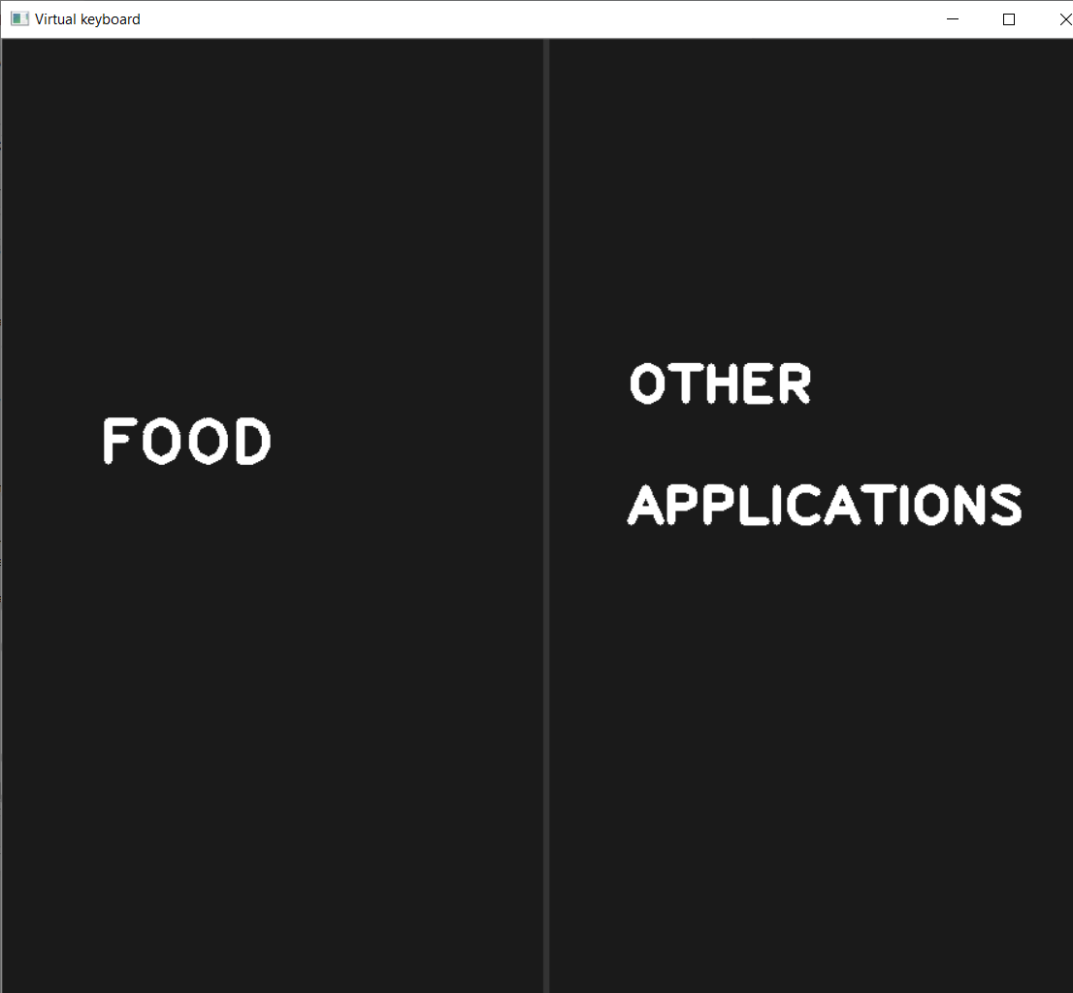
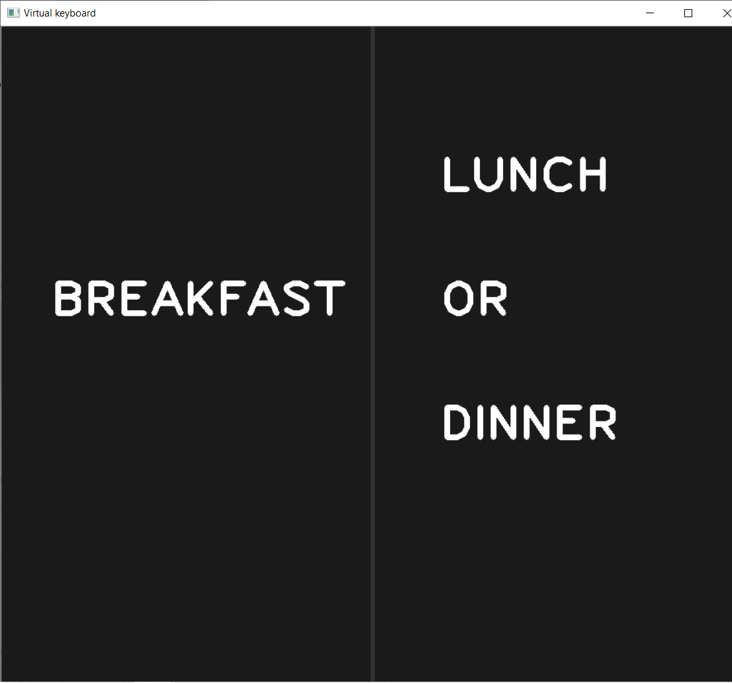
FOOD, OTHER APPLICATIONS
BREAKFAST, LUNCH OR DINNER

Slide 17
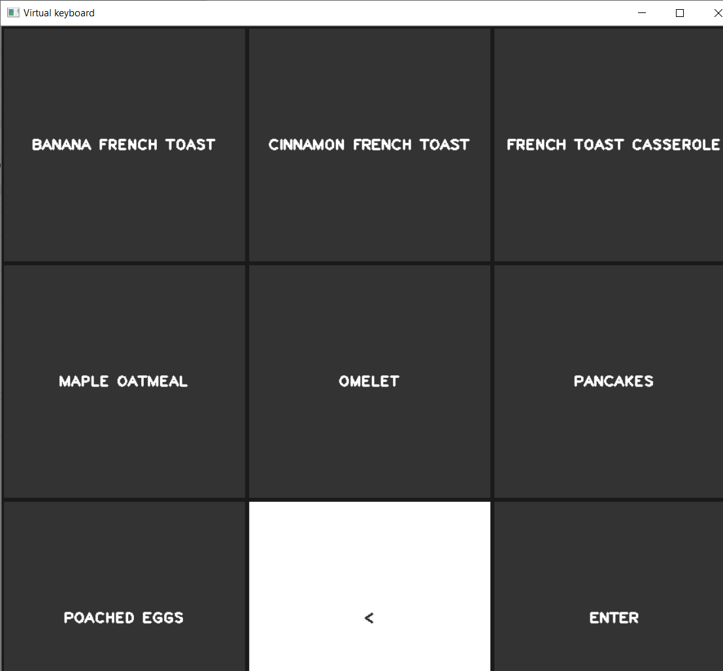
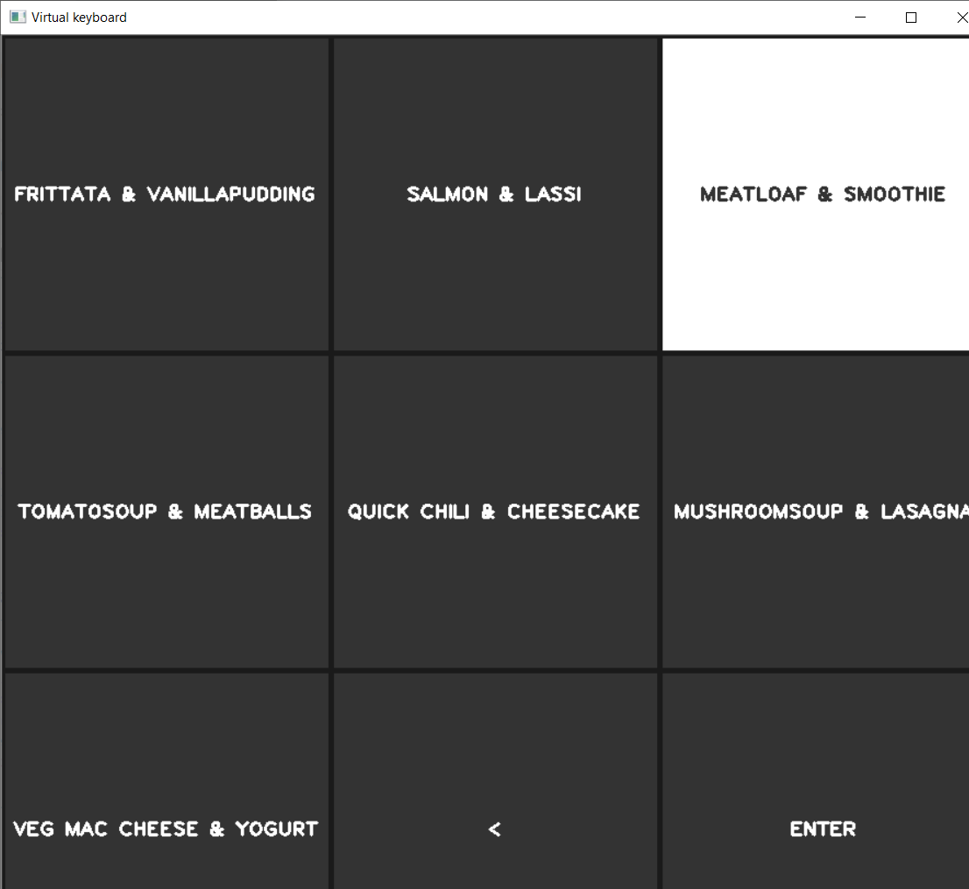
BREAKFAST MENU
LUNCH OR DINNER MENU

Slide 18
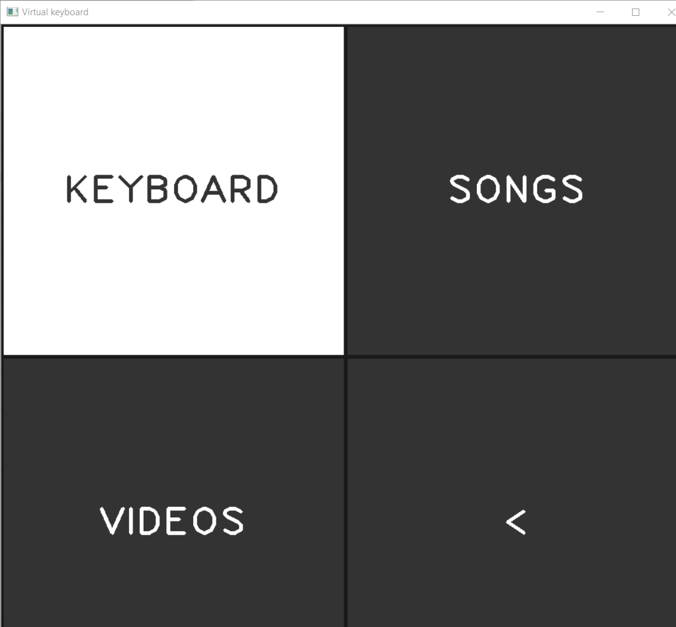
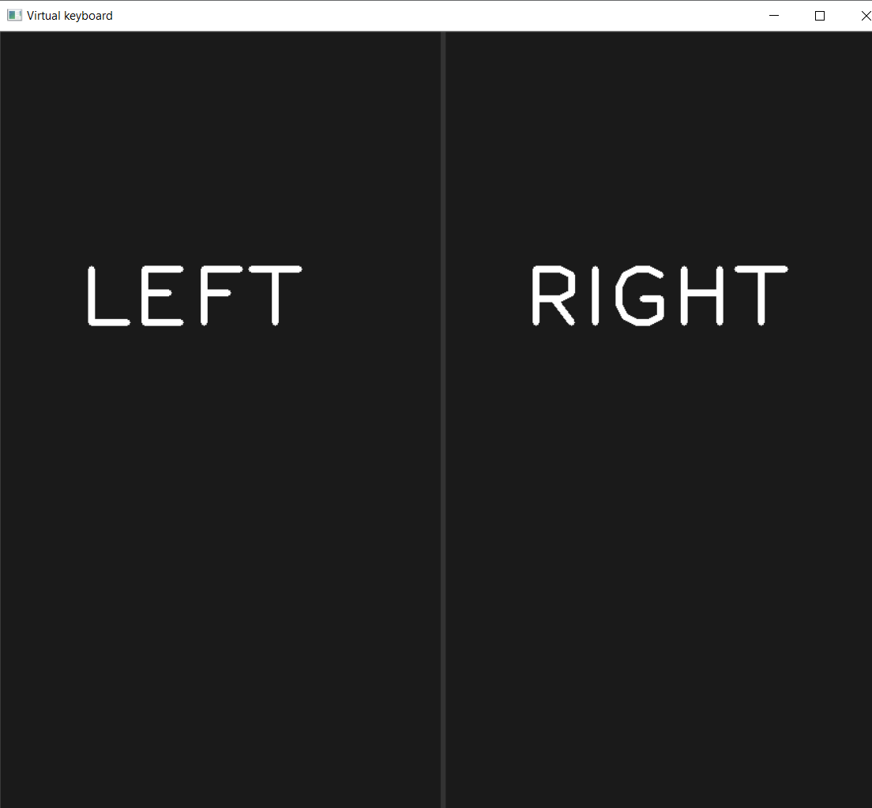
OTHER APPLICATIONS
LEFT, RIGHT

Slide 19
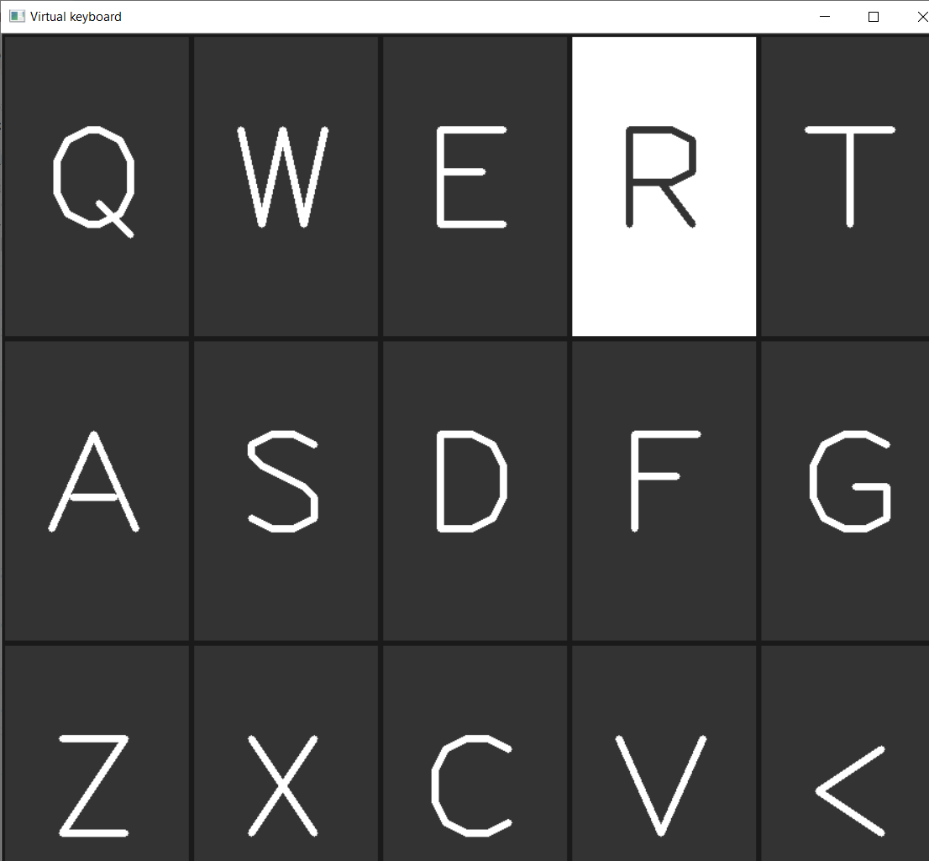
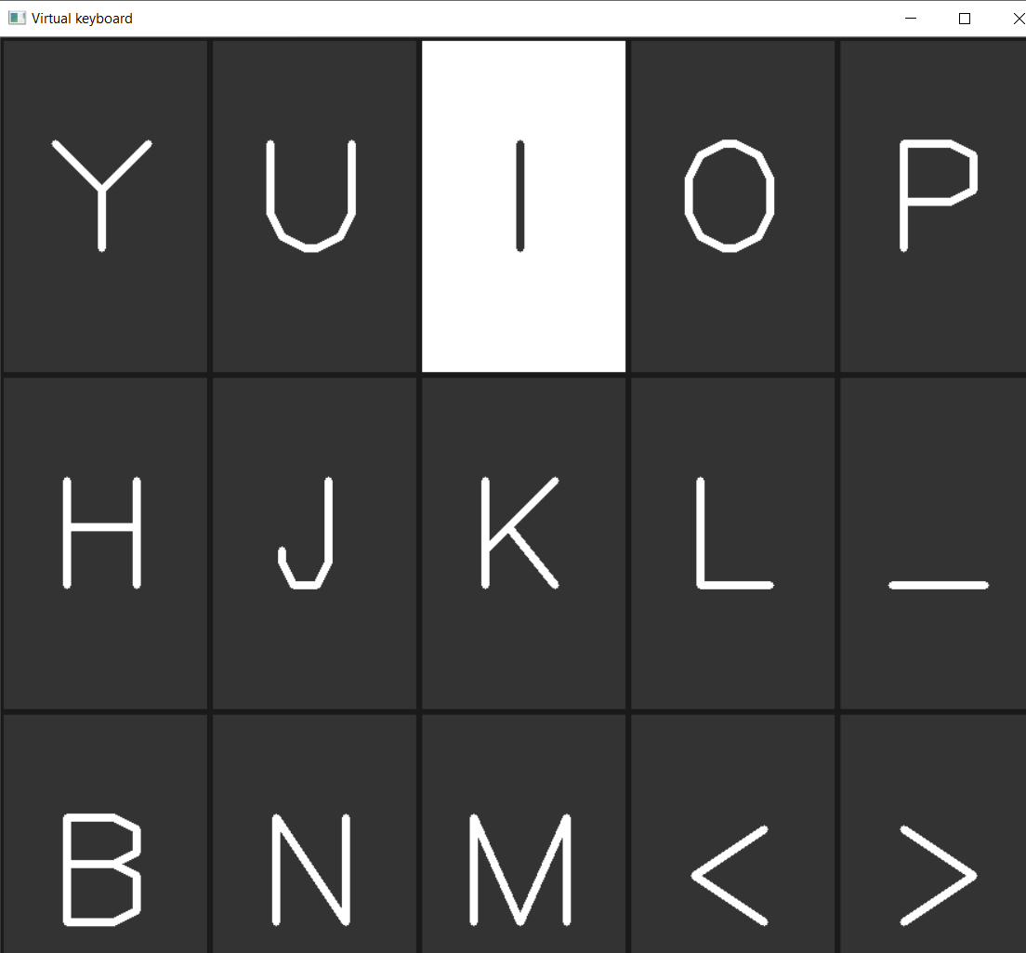
LEFT SIDE OF THE KEYBOARD
RIGHT SIDE OF THE KEYBOARD

Slide 20
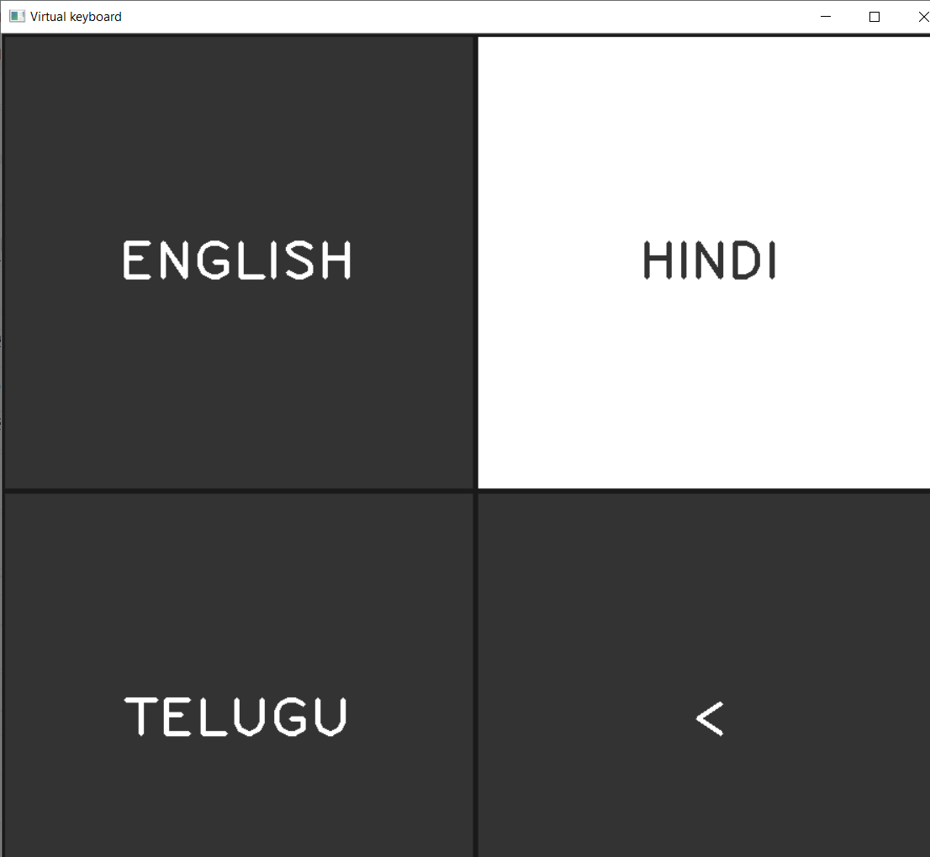
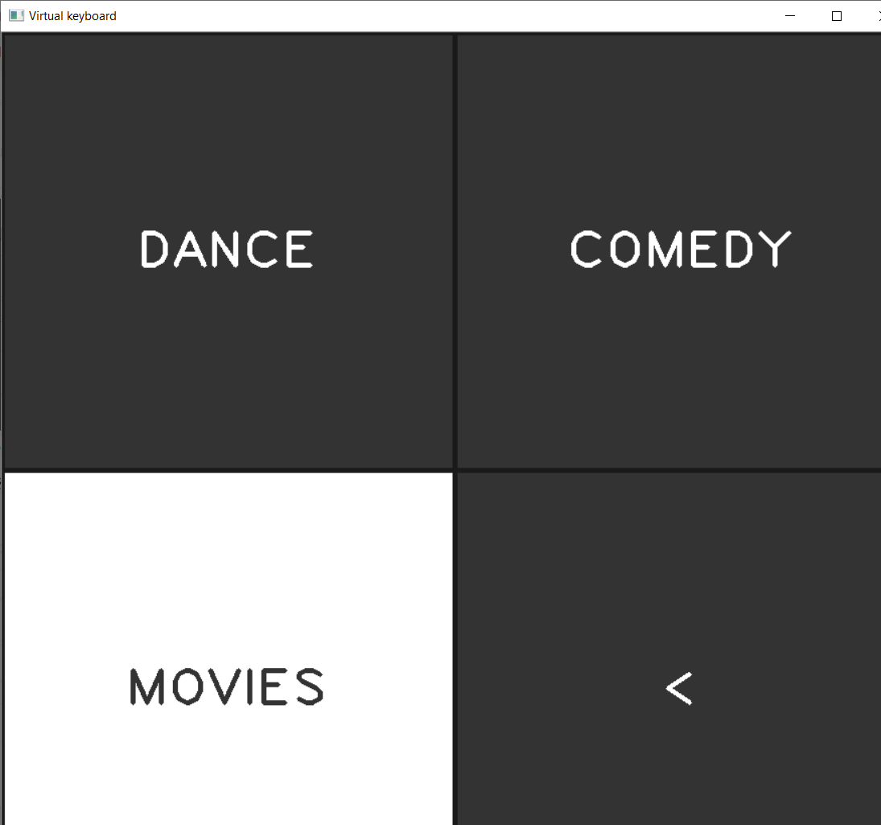
LANG_SELECTION
CATEGORIES

Slide 21
THANK YOU

